Slide 1



Sakila
Store
DVD RENTAL
STORE ANALYSIS
Presented by: Timileyin Anthony

Slide 2
Project Overview
Data Source
Data Preprocessing
Dashboard Overview
Customer Rental Patterns
Customers Popular Genres
Customers Outliner
Customers Spending Patterns
Customer Segmentation
CONTENT

Slide 3

Problem Statement
The DVD rental store is facing challenges in understanding customer behavior and rental trends. Without clear insights into when and what customers prefer to rent, the store struggles to optimize inventory, tailor marketing strategies, and enhance customer satisfaction. The primary issues include:
Unpredictable Rental Patterns: The store cannot accurately forecast high-demand periods and identify seasonal trends.
Lack of Genre Preferences: Unclear understanding of which movie genres are most popular.
Customer Spending Habits: Inadequate knowledge of customer spending patterns and high-value customers and Harmful targeted marketing efforts and loyalty programs.
Unidentified Customer Segments: The inability to segment customers based on rental behavior and demographics.

Slide 4
Data Source
The Sakila Database: A sample database provided by MySQL for a DVD rental store.
Download Link: https://dev.mysql.com/doc/sakila/en/

Slide 5
Data Preprocessing
Data Cleaning: Checked for and handled missing values in all tables to ensure data completeness.
Data Type Conversion: Ensured all columns were in the correct data type format (dates, numeric, categorical) for accurate analysis.Data Transformation: Created a Date column to extract Year, Month, Weekday, and Weekend for trend analysis.
Data Modeling: Established relationships between tables to create a unified dataset for analysis.
DAX Calculations: Set up necessary calculated columns and measures for detailed insights.

Slide 6
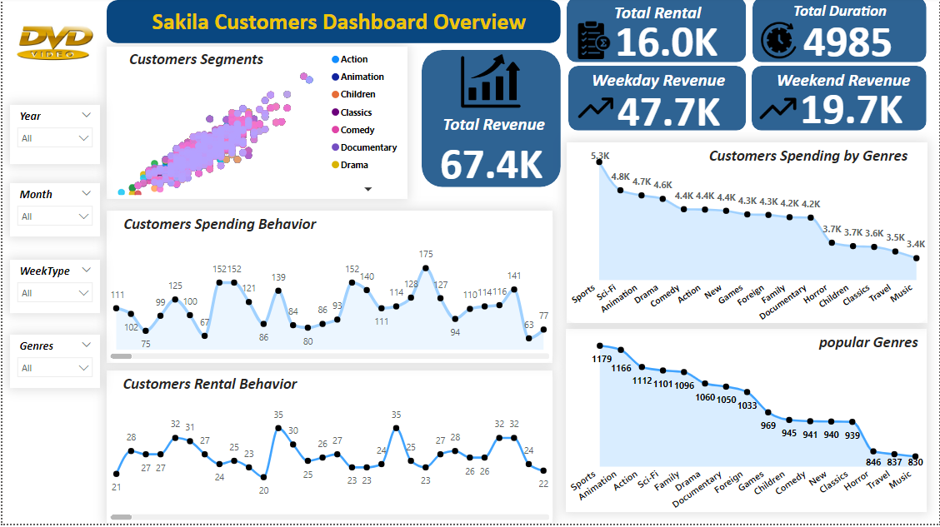
Dashboard Overview

Slide 7
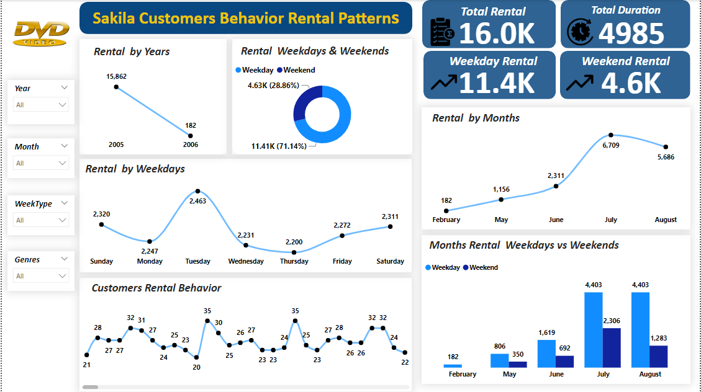
Customer Rental Patterns
Trend Insights
Rentals by Year: The rental activity was extremely high in 2005 and dropped sharply in 2006. This might indicate a significant change in the business.
Rentals by Week Type: Most rentals occur on weekdays, suggesting that customers prefer to rent DVDs during the week.
Rentals by Month: July and August are the peak months for rentals, with a noticeable increase.
Rentals by Weekday: Rentals are fairly consistent throughout the week, with a slight peak on Tuesdays and Sundays.
Monthly Rentals by Weekdays vs. Weekends: There is a clear preference for renting DVDs on weekdays across all months, especially in the summer months (June, July, August).
Customer Behavior: These top customers have very similar rental frequencies, indicating they are highly engaged with the store's services.
Key Insights
July and August see the highest rental activity, likely due to the summer holidays.
Customers tend to rent more DVDs during the weekdays compared to weekends.
Rentals are relatively stable throughout the week with slight increases on Sundays and Tuesdays.
A small group of customers rents very frequently, which could be leveraged for marketing strategies.

Slide 8
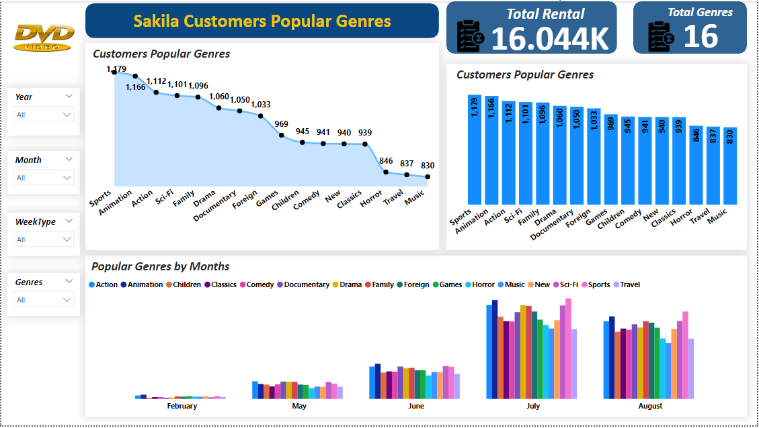
Customers Popular Genres
Key Insights
Our customers have varied tastes, with no single genre dominating the landscape entirely.
The high popularity of family and animation genres indicates that many of our customers are families or have children.
The top genres being sports and action reveal a strong preference for dynamic and exciting content.
The significant interest in documentaries and foreign films suggests our customers value educational content and international perspectives.

Slide 9
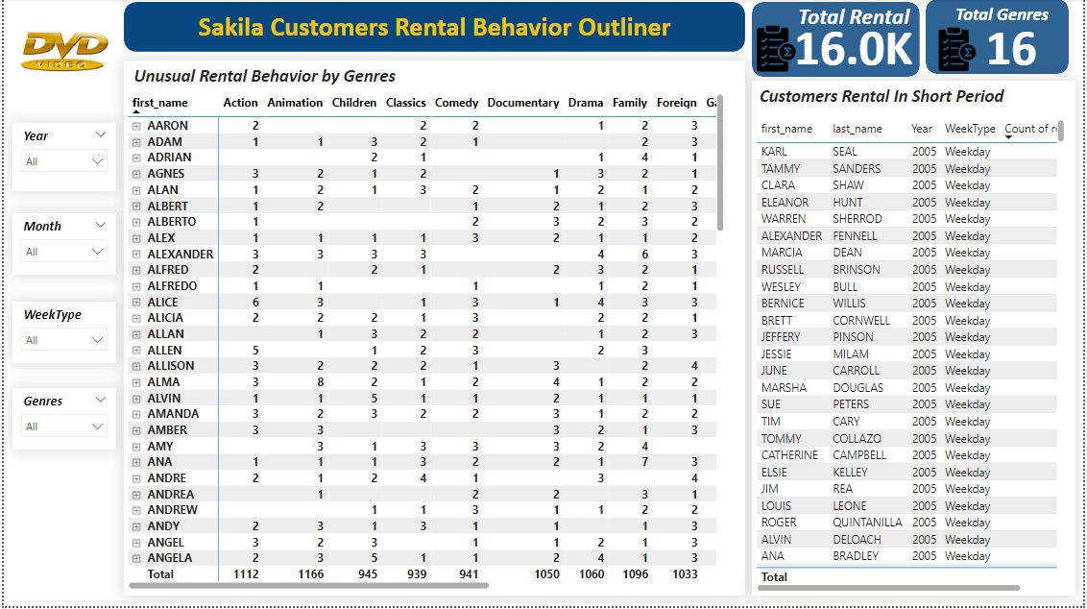
Customers Outliner
Analysis of Unusual
These customers rent an unusually high number of movies. They could have a strong preference for watching a wide variety of genres or might be completing collections.
These customers rented many movies in a short period during weekdays in 2005. They might have had special circumstances, like a long vacation or time off work, allowing them to watch more movies.
Key Insights
Customers like Marion and Jessie, with high rental counts, are key to our business. Their behavior indicates a strong interest in our offerings.
The high rental numbers by customers like Eleanor Hunt during weekdays in 2005 suggest a demand for weekday entertainment.

Slide 10
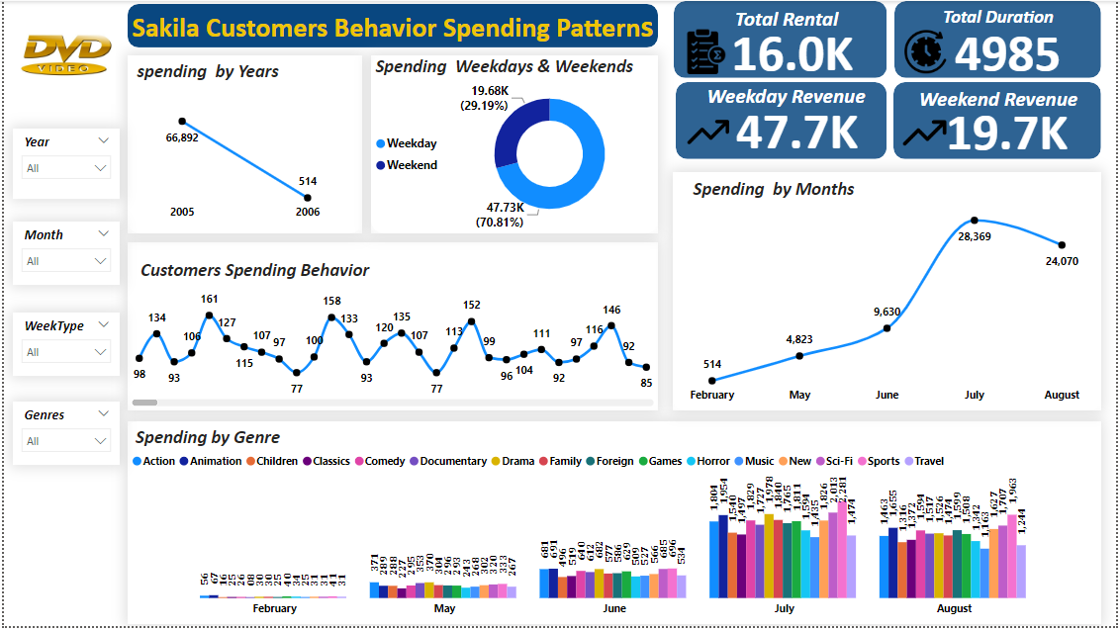
Customers Spending Patterns
Key Insights
Spending by Year: Comparing 2005 and 2006, we see an increase in spending, suggesting growth in customer engagement.
Spending by Weekdays & Weekends: Weekdays appear to be the most popular for spending, with 70.81% of the total, compared to 29.19% on weekends.
Spending by Month: February and May were relatively low spending months, while July saw a significant jump in spending, suggesting a seasonal trend .
Top Customer Spending Behavior: These five top spenders each spent nearly $200 or more, indicating potential for high-value customer segmentation and personalized marketing strategies.

Slide 11
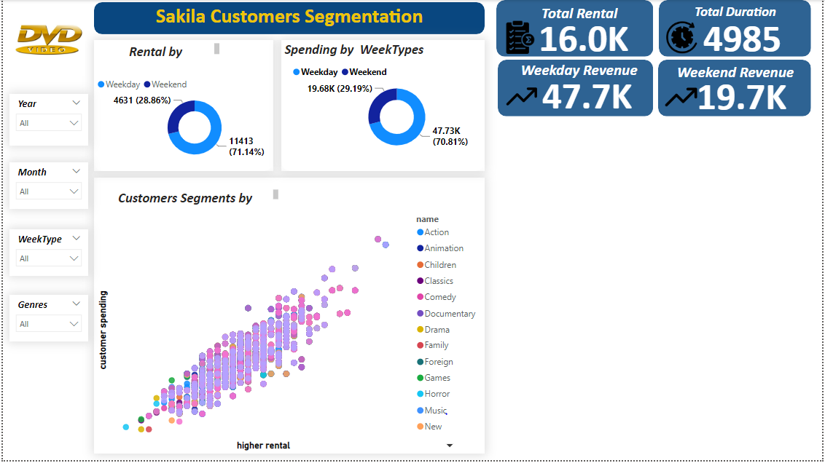
Customer Segmentation
Key Insights
There is a relationship between the customer's rental and the customer's spending

Slide 12
Recommendation
Target Weekday Promotions: Launch special promotions and discounts for weekday rentals to capitalize on the higher rental activity.
Seasonal Promotions: Implement summer holiday promotions in July and August to boost rentals further.
Loyalty Programs: Develop loyalty programs to reward frequent renters, encouraging continued engagement.
Diverse Content Acquisition: Invest in a wider variety of genres, including educational content like documentaries and foreign films, to cater to diverse customer interests.
Weekday Spending Focus: Enhance marketing efforts on weekdays, possibly introducing weekday-exclusive deals to maximize spending.

Slide 13
THANK YOU

